Slide 1
School Management System
Group -84
Presented By:
Hardik Patil 210541281131
Akshay Morale 210541281111
Guided By: Mr. Chetan Pardeshi

Slide 2
Agenda
Project Introduction
Project Architecture
Technology platform used for project
User roles and responsibilities
Future extensions if any
Conclusion

Slide 3
Project Introduction
Purpose of the project
Modern age , where computer has become a way of life, existing system for a school is based on our traditional way keeping records and details on paper and registers.
Access of these details and papers are not granted to common member in absence of the authority. It is hard to manage all the school system with pen and paper.
It gets really hard to maintain the records and then keep track of past records
School Management System provides facility to automate the existing manual system by the help of computerized equipment , so that their valuable data can be stored for a longer period with easy accessing and manipulation of the same.
In this Covid situation, teachers can easily provide feedback about students , which parents can monitor and help them in improvement.

Slide 4
Project Introduction
Need
Earlier, data pertaining to students and teachers was maintained manually
In current situation covid situation it is hard for teachers to give personal attention to students.
The manual procedures are error prone and not efficient and also not suitable for electronic data exchange.

Slide 5
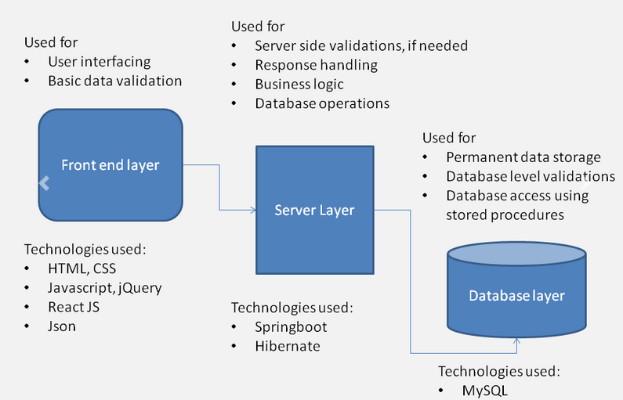
Project Architecture

Slide 6
Technology platform used for projects
Technology used
Java
Spring Boot REST API
Spring Security
JPA(Java Persistence API)
jjwt 0.9.1
React JS
Bootstrap
MySQL

Slide 7
Users role and responsibilities
Admin -Data collection and manipulation of teachers and students.
Teacher-View list of students, update attendance and feedback of students.
Student-View profile, View feedbacks provided by teachers

Slide 8
Future extensions if any
We will deploy it on cloud.
We will add some features like assignment update and submission, application for leave, curriculum progress.

Slide 9
Conclusion
School Management System provides better platform to get connected with students and teachers.
System provides a very user –friendly platform where teachers can easily maintain the student details also will be able to provide feedbacks so students can work in that direction
student can easily checkout feedbacks from particular which will help them in self-improvement.

Slide 10
THANK YOU

